Slide 1
Wikipedia Dataset Analysis
Revature Project 1
Christopher Chee

Slide 2
1. Which English Wikipedia article got the most traffic on October 20?

Slide 3
1. Which English Wikipedia article got the most traffic on October 20?
Data Used:
All Pageviews for October 20, 2020

Slide 4
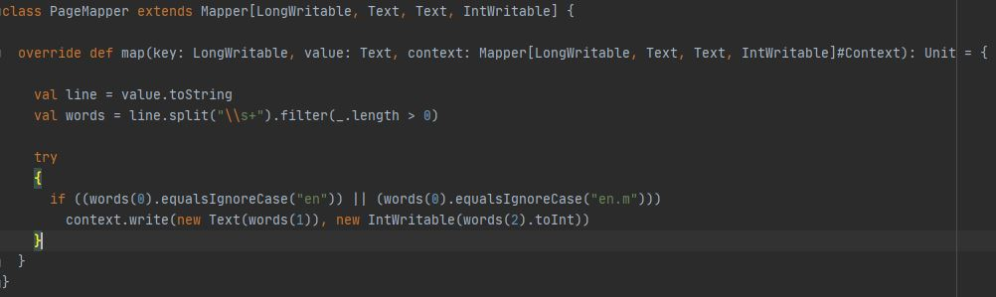
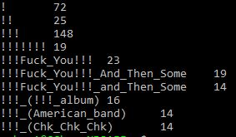
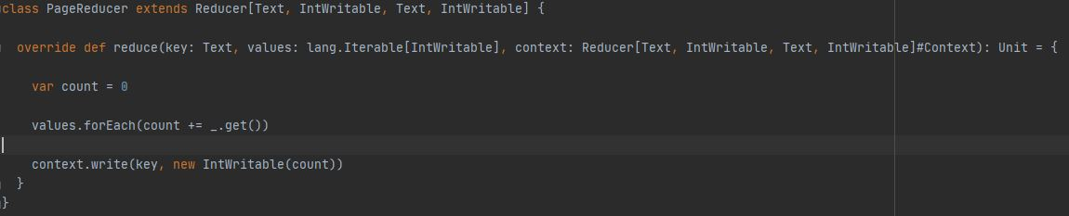
1. Which English Wikipedia article got the most traffic on October 20?
Format of MapReduce output

Slide 5
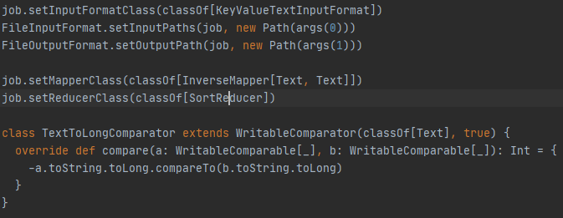
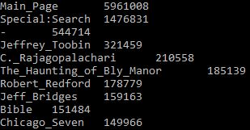
1. Which English Wikipedia article got the most traffic on October 20?
Top 10 viewed pages

Slide 6
2. What English Wikipedia article has the largest fraction of its readers follow an internal link to another Wikipedia article?

Slide 7
2. What English Wikipedia article has the largest fraction of its readers follow an internal link to another Wikipedia article?
Data Used:
Clickstream for the month of Sept.
All Pageviews for the month of Sept.

Slide 8
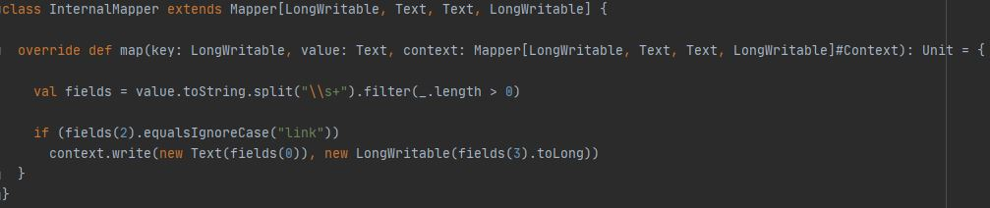
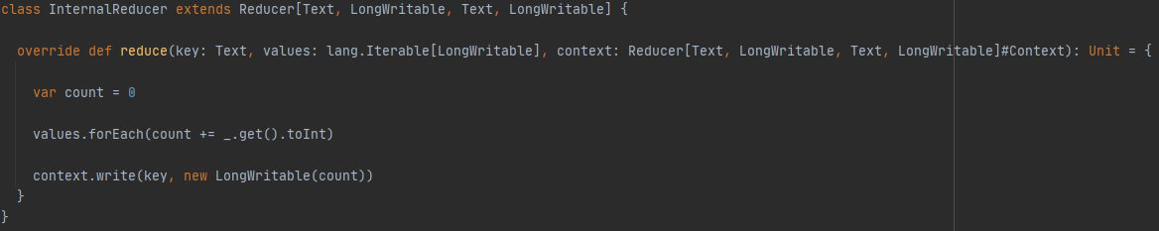
2. What English Wikipedia article has the largest fraction of its readers follow an internal link to another Wikipedia article?

Slide 9
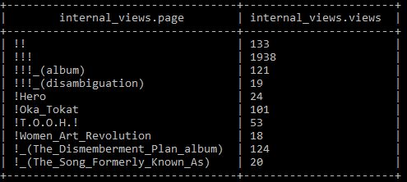
2. What English Wikipedia article has the largest fraction of its readers follow an internal link to another Wikipedia article?
Format of MapReduce output

Slide 10
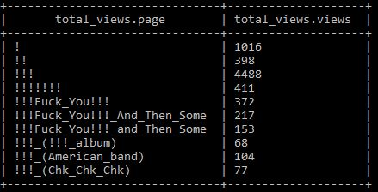
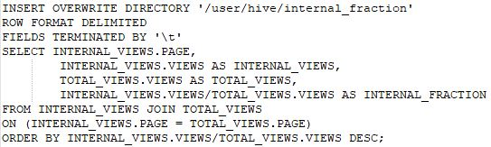
2. What English Wikipedia article has the largest fraction of its readers follow an internal link to another Wikipedia article?
JOIN

Slide 11
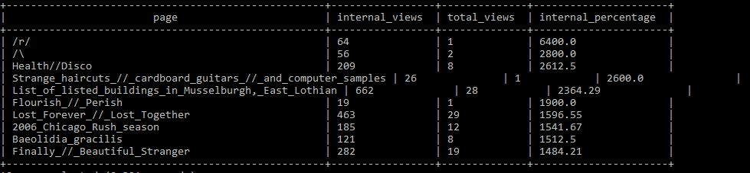
2. What English Wikipedia article has the largest fraction of its readers follow an internal link to another Wikipedia article?
Invalid results

Slide 12
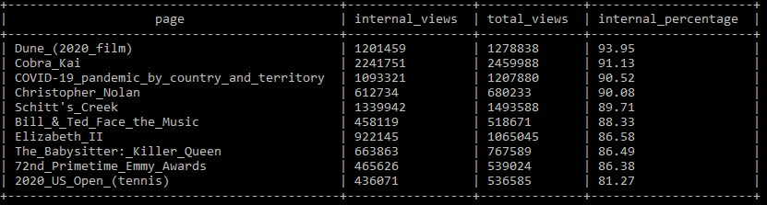
2. What English Wikipedia article has the largest fraction of its readers follow an internal link to another Wikipedia article?
Filtered results

Slide 13
3. What series of Wikipedia articles, starting with Hotel California, keeps the largest fraction of its readers clicking on internal links?

Slide 14
3. What series of Wikipedia articles, starting with Hotel California, keeps the largest fraction of its readers clicking on internal links?
Data Used:
Clickstream for the month of Sept.
All Pageviews for the month of Sept.

Slide 15
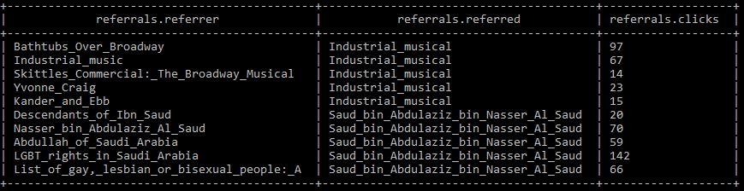
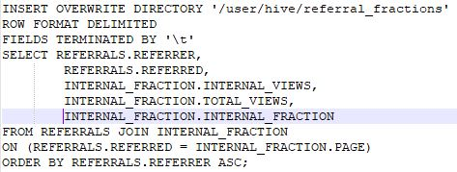
3. What series of Wikipedia articles, starting with Hotel California, keeps the largest fraction of its readers clicking on internal links?
JOIN

Slide 16
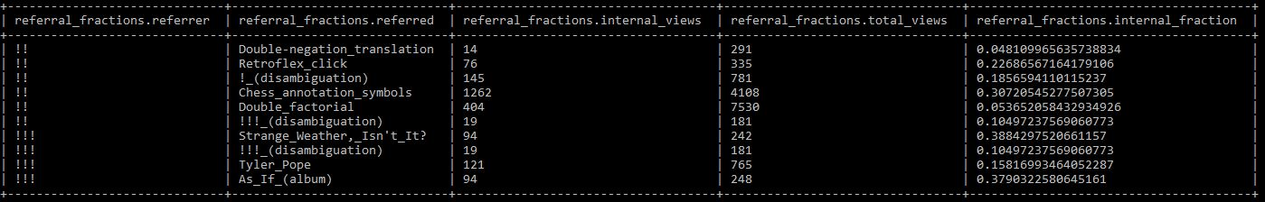
3. What series of Wikipedia articles, starting with Hotel California, keeps the largest fraction of its readers clicking on internal links?
Resulting table from join

Slide 17

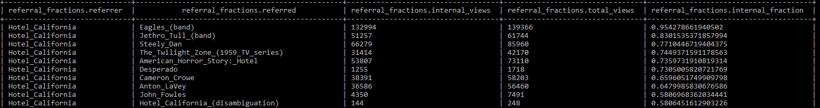
3. What series of Wikipedia articles, starting with Hotel California, keeps the largest fraction of its readers clicking on internal links?
Hotel_California -> Eagles_(band) (95.4%)

Slide 18

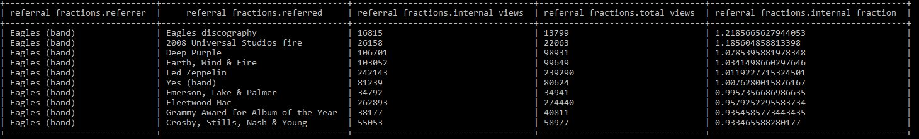
3. What series of Wikipedia articles, starting with Hotel California, keeps the largest fraction of its readers clicking on internal links?
Hotel_California -> Eagles_(band) (95.4%) -> Emerson,_Lake_&_Palmer (99.6%)

Slide 19

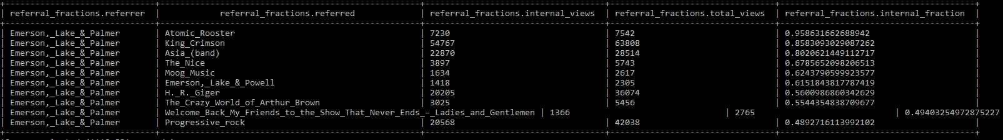
3. What series of Wikipedia articles, starting with Hotel California, keeps the largest fraction of its readers clicking on internal links?
Hotel_California -> Eagles_(band) (95.4%) -> Emerson,_Lake_&_Palmer (99.6%) -> Atomic_Rooster (95.9%)

Slide 20

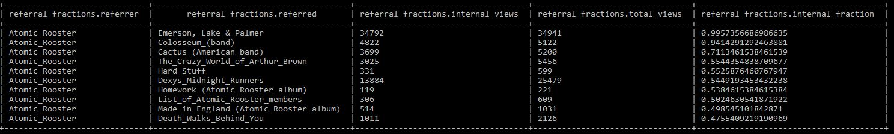
3. What series of Wikipedia articles, starting with Hotel California, keeps the largest fraction of its readers clicking on internal links?
Hotel_California -> Eagles_(band) (95.4%) -> Emerson,_Lake_&_Palmer (99.6%) -> Atomic_Rooster (95.9%) -> Emerson,_Lake_&_Palmer

Slide 21
4. Find an example of an English Wikipedia article that is relatively more popular in the UK. Find the same for the US and Australia.

Slide 22
4. Find an example of an English Wikipedia article that is relatively more popular in the UK. Find the same for the US and Australia.
Data Used:
Pageviews during peak internet traffic hours (7 – 9 PM)
Used 1 week of pageview data from Sept. 21 - 25 (Mon – Fri)
Assumptions:
Peak internet traffic hours is similar in these countries
Traffic during peak hours is representative of traffic all the time
Wikipedia traffic during peak hours is representative as well

Slide 23
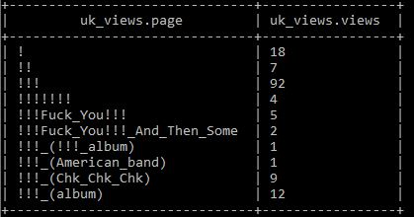


4. Find an example of an English Wikipedia article that is relatively more popular in the UK. Find the same for the US and Australia.
Sum of views during UK peak hours

Slide 24
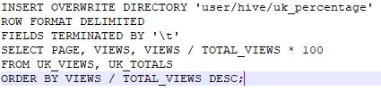
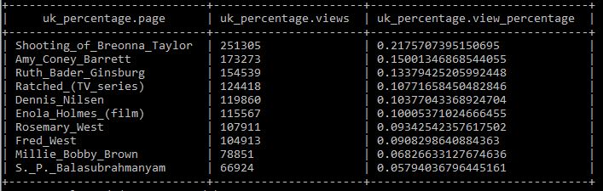
4. Find an example of an English Wikipedia article that is relatively more popular in the UK. Find the same for the US and Australia.
Percentage of total views per article

Slide 25
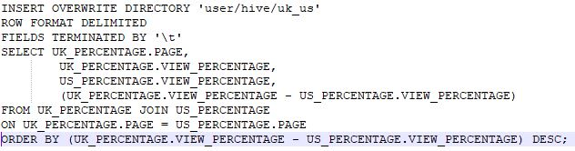
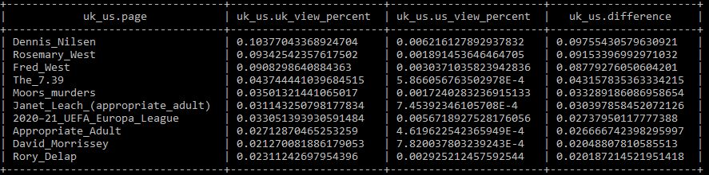

4. Find an example of an English Wikipedia article that is relatively more popular in the UK. Find the same for the US and Australia.
Dennis_Nilsen comparison
$$\frac{0.10377}{0.006216}=16.694$$
UK Page Views vs US Page Views

Slide 26
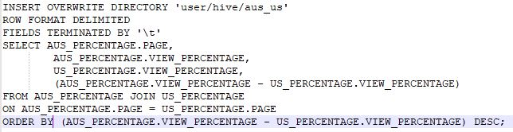
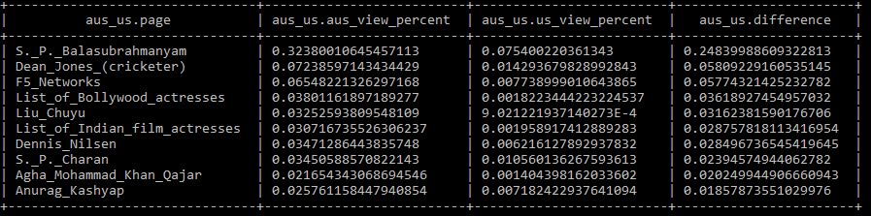


4. Find an example of an English Wikipedia article that is relatively more popular in the UK. Find the same for the US and Australia.
Dean_Jones_(cricketer)
$$\frac{0.07238}{0.01429}=5.065$$
List of Bollywood actresses
$$\frac{0.03801}{0.001822}=20.86$$
Australia Page Views vs US Page Views

Slide 27
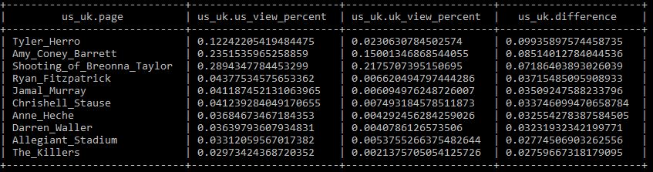
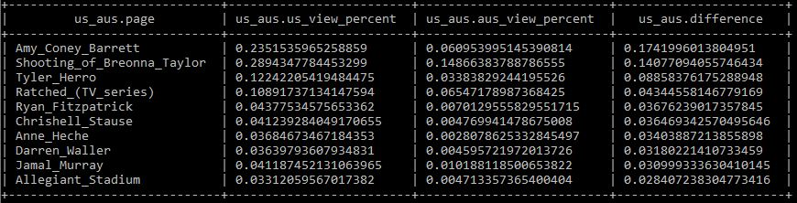






4. Find an example of an English Wikipedia article that is relatively more popular in the UK. Find the same for the US and Australia.
vs UK
vs Australia
(+ India)
Tyler Herro
$$\frac{0.1224}{0.02306}=5.307$$
$$\frac{0.1224}{0.03383}=3.618$$
US Page Views vs UK Page Views
Amy Coney Barrett
$$\frac{0.2351}{0.1500}=1.567$$
$$\frac{0.2351}{0.06095}=3.857$$
Shooting of Breonna Taylor
$$\frac{0.2894}{0.2175}=1.33$$
$$\frac{0.2894}{0.1486}=1.947$$
US Page Views vs Australia Page Views

Slide 28
5. Analyze how many users will see the average vandalized Wikipedia page before the offending edit is reversed.
Data used:
MediaWiki enwiki history up to October 2020
Pageviews for October 20, 2020
Assumptions:
All revisions that were reverted were vandalizations
Total views over a day are representative of normal traffic

Slide 29
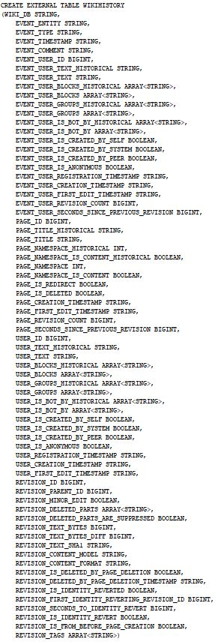
5. Analyze how many users will see the average vandalized Wikipedia page before the offending edit is reversed.

Slide 30

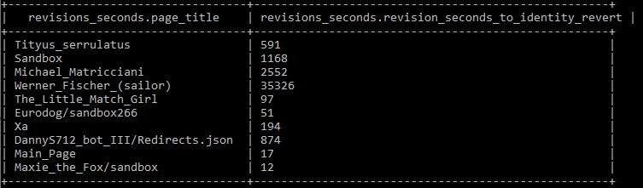
5. Analyze how many users will see the average vandalized Wikipedia page before the offending edit is reversed.
Time (in seconds) before reverting change on page

Slide 31


5. Analyze how many users will see the average vandalized Wikipedia page before the offending edit is reversed.
Average time before vandalization is reverted

Slide 32


5. Analyze how many users will see the average vandalized Wikipedia page before the offending edit is reversed.
Average time before vandalization is reverted
Average views an article receives per day

Slide 33
5. Analyze how many users will see the average vandalized Wikipedia page before the offending edit is reversed.
Average time before vandalization is reverted
Average views an article receives per day
$$\frac{96795.538 seconds}{revert} x \frac{1 minute}{60 seconds} x \frac{1 hour}{60 minutes} x \frac{1 day}{24 hours}= \frac{1.12 days}{revert}$$

Slide 34

5. Analyze how many users will see the average vandalized Wikipedia page before the offending edit is reversed.
Average time before vandalization is reverted
Average views an article receives per day
$$\frac{96795.538 seconds}{revert} x \frac{1 minute}{60 seconds} x \frac{1 hour}{60 minutes} x \frac{1 day}{24 hours}= \frac{1.12 days}{revert}$$
$$\frac{1.12 days}{revert} x \frac{38.663 views}{day} = \frac{43.303 views}{revert}$$

Slide 35
6. Which popular English Wikipedia pages have the lowest percentage of people click an internal link?

Slide 36
6. Which popular English Wikipedia pages have the lowest percentage of people click an internal link?
Data Used:
Clickstream for the month of Sept.
All Pageviews for the month of Sept.

Slide 37

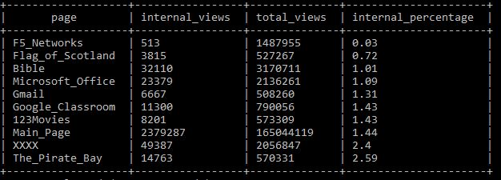
6. Which popular English Wikipedia pages have the lowest percentage of people click an internal link?
10 popular pages with lowest percentage

Slide 38
Questions?

Slide 39
GitHub: https://github.com/ChrisChee1/RevatureProject1

